Slide 1
THE CHITLIN’ CIRCUIT
BY (WRITE YOUR NAME HERE)

Slide 2

THE CHITLIN’ CIRCUIT
This is one symbolic of the nature and the lifestyles that were prescribed to the black people in the times of extreme racial discrimination towards the end of 19th century in the United States.
It is graphically represented like in the following slides.

Slide 3
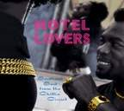
THE LIVISTS
The Stroll became a cornerstone upon which a bigger majority of the town came surged in numbers looking for a sure means of entertainment which they had in bounties.

Slide 4
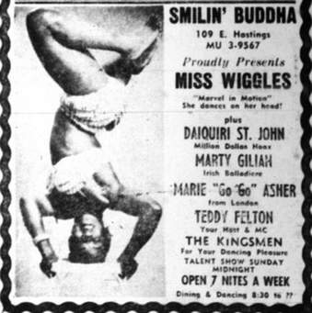
THE CHOREOGRAPHERS
Chitlin Circuit majored on the ground performance of music in terms of its organization in clubs, choreographed dances and creativity.

Slide 5
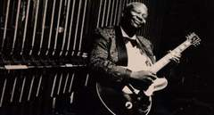
THE GUITERIST
Chitlin’ circuit gave room for special black talents. It was emancipation of all abilities

Slide 6
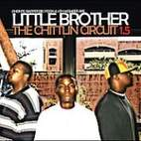
THE BAND
Circuit as a movement paved way and gave room for rebirth of other bands such as Little Brother Clouds of Joy or Smiling and Celery City Serenaders.

Slide 7
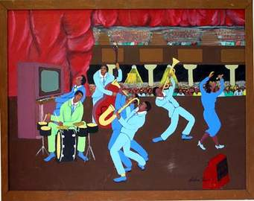
THE DANCERS
The movement entailed performances of all types with all the musical related instruments. Hosted in theatres and clubs.

Slide 8
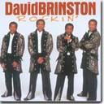
THE ARTISTS
It is said that music transcends and galvanizes emotions and that is exactly what the above mentioned two bands did.

Slide 9

THE LADY BOOKERS
Through Lauterbach’s book (The Chitlin Circuit and the Road to Rock ‘n’ Roll) we find the roles and the undertakings of women folk in the participation of the movement.

Slide 10
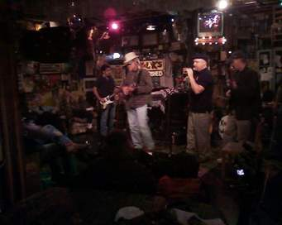
THE FRIDAY NIGHTS
Like the modern eateries restaurants and bars, the Stroll became a cornerstone upon which a bigger majority of the town came surged in numbers looking for a sure means of entertainment which they had in bounties.

Slide 11
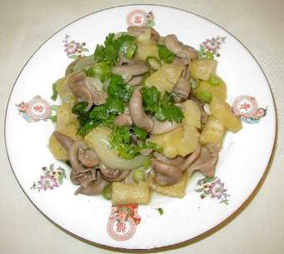
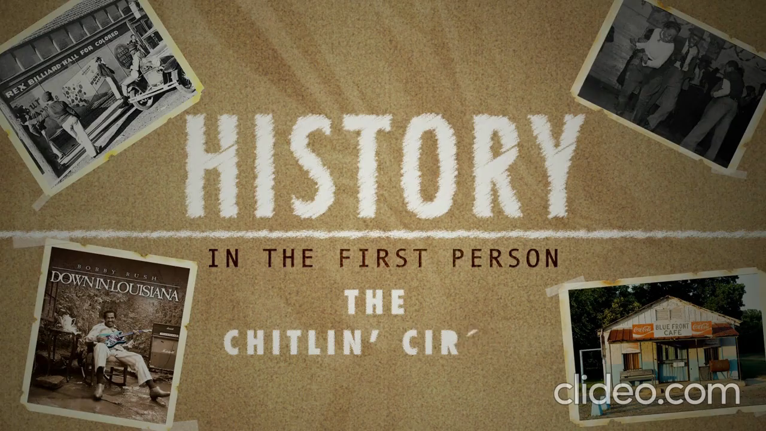
THE ORIGIN OF THE NAME CHITLIN’
The name Chitlin’ is a derogative comparison of a pig’s intestines, the food that the blacks survived on as opposed to what the whites took.

Slide 12
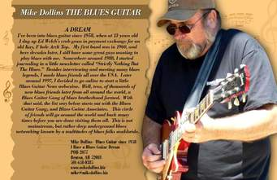
THE OCCASIONAL GUESTS
They soothed their melodies through the hearts of audiences as they also created platforms that gave job opportunities to the majority inhabitants of the towns they stayed to play and to make money.

Slide 13
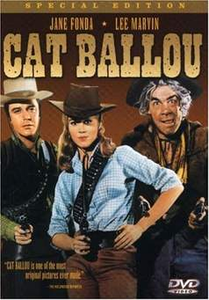
THE EXCEPTIONAL THRILLERS
The movement provided a creative way of art formation for all groups including the group singers and comedians. Most comedies were influenced by the surroundings such as farmlands for cowboys among others.

Slide 14
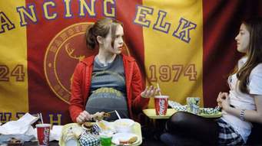
THE AUDIENCE
The movement encompassed attraction of crowds of all kinds.
They used ordinary life events like pregnancy to capsulate their content needs which frenzied the audience.

Slide 15
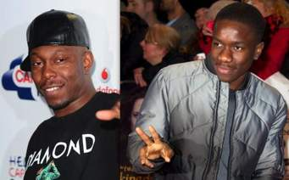
THE DISCIEPLES
It is a base that has cropped the genres such as the jazz music, the pop music among others that borrow largely from the ordinances of movement

Slide 16
CONCLUSION
The underlying contributions of this movement are stored in the roles the women played in the movement, what it stood for( hiring of blacks) in the entertainment joints and eventual motivation to participating in the civil emancipation of black’s equal treatment.

